Slide 1

CS47: Cross-Platform Mobile Development
Lecture 9A: Firebase Storage + authentication
Faculty Advisor
Instructor #1
Fall 2019
https://class.website
class.slack.com

Slide 2

Overview for Today
Facebook login
Firebase Storage Overview
Firebase upload example
Firebase download solution

Slide 3


Facebook login
+
Facebook login docs

Slide 4
Steps
Create a Facebook developer account
Create an app
Go to settings/basic on the left, and follow the Expo guide
Copy the code from Expo. Make sure to enter your correct App_ID
Yay! FB login works
Optional, but likely you wanna do it: Save token and expiration date locally. No one likes to login again every time

Slide 5
Demo

Slide 6
Overview for Today
Facebook login
Firebase Storage Overview
Firebase upload example
Firebase download solution

Slide 7
What is Firebase Storage?
Cloud Storage for Firebase lets you upload and share user generated content, such as images and video.
USEFUL LINKS / Firebase Cloud Storage Docs
Notes:
Show the console storage

Slide 8
How do you use Firebase Cloud Storage?
Go to Firebase Console
Create an app (cannot use Stanford email)
Go to storage and get started
Similar to Firestore, install Firebase ( npm install --save firebase )
Copy firebase config from the console (make sure the app you created is a web app)
Put the code somewhere accessible for your app (a firebase.js file for instance)
Import firebase in your screen
USEFUL LINKS / Firebase Cloud Storage Docs

Slide 9
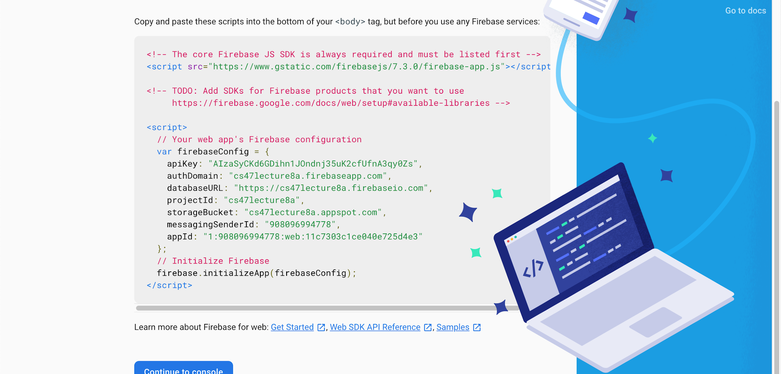
5
Copy code

Slide 10
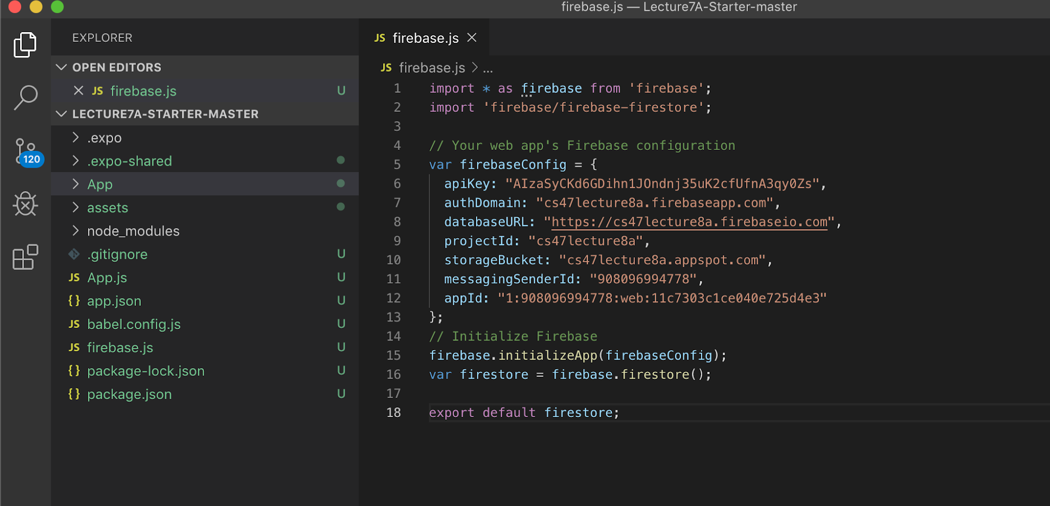
6
Create a firebase.js file and paste code

Slide 11
How do you use Firebase Cloud Storage?
Go to Firebase Console
Create an app (cannot use Stanford email)
Go to storage and get started
Similar to Firestore, install Firebase ( npm install --save firebase )
Copy firebase config from the console (make sure the app you created is a web app)
Put the code somewhere accessible for your app (a firebase.js file for instance)
Import firebase in your screen
USEFUL LINKS / Firebase Cloud Storage Docs

Slide 12
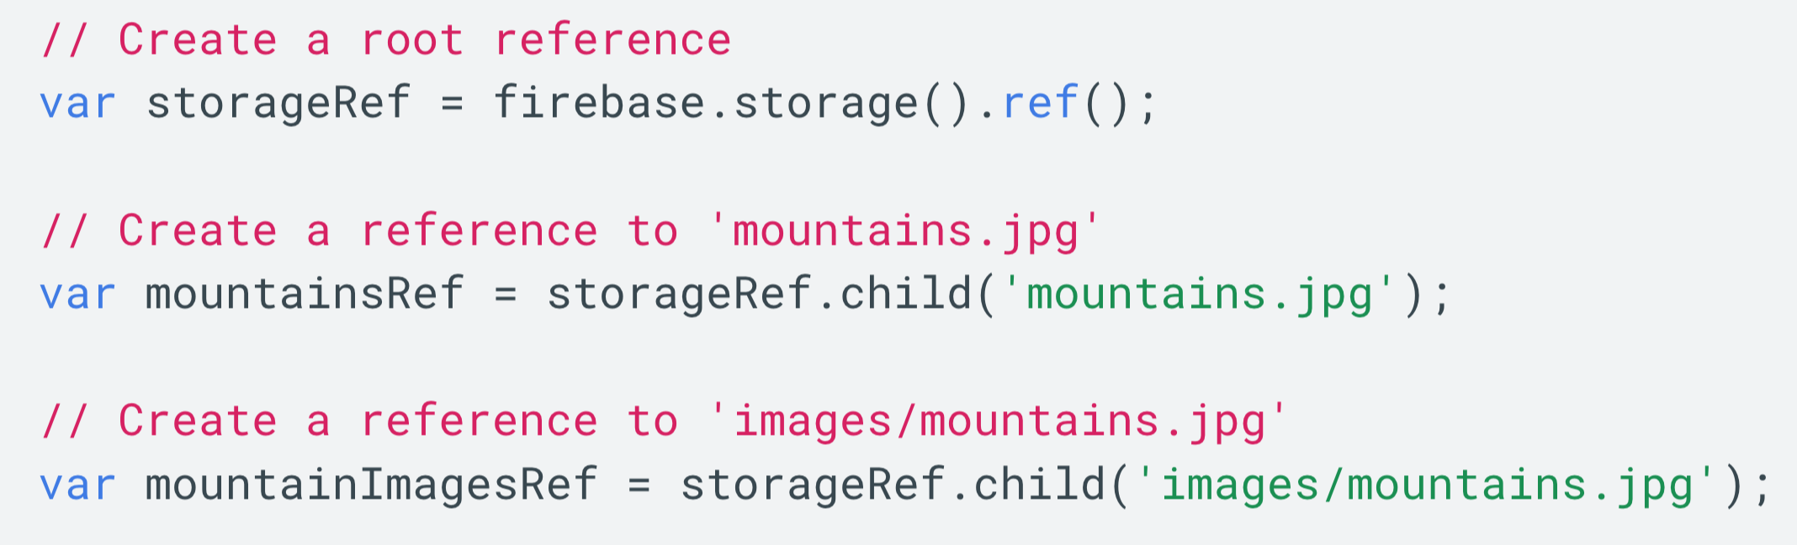
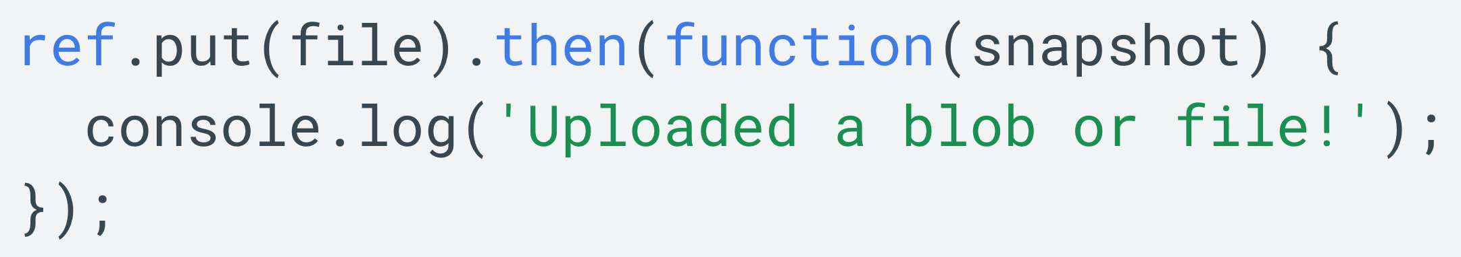
Uploading to firebase
First, obtain a reference
Second, put file there
USEFUL LINKS / Firebase Cloud Storage Docs

Slide 13
Getting local files
Use ImagePicker from Expo
Get photos from camera
Get photos from camera roll
Note: You need permissions first!

Slide 14
Getting local files
Use ImagePicker from Expo
Get photos from camera
Get photos from camera roll
Note: You need permissions first!
Some implementation details
You will get a uri
We will “fetch(uri)”
Turn fetched data to blob
The blob will be given to firebase storage

Slide 15
Demo

Slide 16
CS47: Cross-Platform Mobile Development
Lecture 9A: Firebase Storage + authentication
Faculty Advisor
Instructor #1
Fall 2019
https://class.website
class.slack.com

